Slide 1


SIMATS ENGINEERING Saveetha Institute of Medical and Technical Sciences Chennai-602105.
DevOps-Driven Deployment of a Gamified Pediatric Dental Care Platform Using Docker, Jenkins, and Kubernetes
Guided by:
DR.T.M.USHA
Institute of SIMATS
Saveetha School of Engineering
Presented By:
S. Ravi Sankar Reddy(192372214)
I. Hemanth Reddy(192311222)
P. Lohith Krishna(192325122)
Y. Krishna Tejesh Reddy(192411200)
K. Madan Mohan Reddy(192411206)

Slide 2
Introduction
Paediatric dental care is essential for maintaining children's oral health and preventing dental diseases.
Children often lack interest in traditional dental education, leading to poor oral hygiene habits.
Gamification improves engagement through quizzes, badges, rewards, and progress tracking.
Healthcare applications require secure, reliable, and scalable deployment.
Traditional deployment methods are manual, slow, and prone to errors.
DevOps integrates development and operations to automate software delivery.
Docker is used for application containerization and environment consistency.

Slide 3
Objectives
To develop a gamified paediatric dental care platform that promotes oral hygiene awareness among children.
To implement Docker for application containerization and consistent deployment environments.
To automate the software build, testing, and deployment process using Jenkins CI/CD.
To deploy and manage the application using Kubernetes for orchestration and scalability.
To improve application availability, reliability, and fault tolerance.
To reduce deployment time and minimize manual deployment errors through DevOps automation.

Slide 4
Problem Statement
Traditional deployment methods for healthcare applications are manual, time-consuming, and prone to errors.
Frequent application updates are difficult to deploy efficiently, resulting in increased downtime and delayed feature releases.
Healthcare platforms require high availability, scalability, and reliability to support continuous user access.
There is a need for a DevOps-driven deployment solution that uses Docker for containerization, Jenkins for CI/CD automation, and Kubernetes for orchestration to enable a scalable, reliable, and efficient deployment of a gamified pediatric dental care platform.

Slide 5
GitHub
GitHub :
GitHub is a cloud-based platform for hosting and managing Git repositories.
It enables developers to store, track, and collaborate on source code.
It maintains version history, making it easy to monitor and restore changes.
GitHub integrates seamlessly with Jenkins to trigger automated CI/CD pipelines.
It supports collaborative software development through features like pull requests and code reviews.
Benefits:
Centralized code repository
Version control and change tracking
Easy team collaboration
Integration with Jenkins, Docker, and Kubernetes
Secure code backup and management

Slide 6
Docker
Docker:
Open-source containerization platform.
Packages applications with all dependencies into containers.
Fast, lightweight, and portable deployment.
Simplifies application distribution and maintenance.
Benefits:
Environment consistency
Faster deployment
Easy portability
Efficient resource utilization

Slide 7
Jenkins
Jenkins :
Open-source CI/CD automation tool.
Automates build, testing, and deployment processes.
Integrates with Git, Docker, and Kubernetes.
Supports continuous software delivery.
Reduces manual effort and deployment errors.
Benefits :
Automated workflows
Faster software releases
Improved code quality
Continuous Integration & Continuous Delivery (CI/CD)

Slide 8
Kubernetes
Kubernetes :
Manages and deploys Docker containers efficiently.
Automatically scales applications based on demand.
Provides load balancing and self-healing features.
Ensures high availability and reliability.
Benefits :
Auto-scaling
Load balancing
High availability
Self-healing containers
Easy container management

Slide 9
Module : Facilitate appointment tracking and reminders to improve recall visits.

Slide 10
Module 1: Gamified Pediatric Dental Care Platform Gamification – adds points, badges, rewards, and levels to encourage children. Dental Education – provides interactive lessons, games, and quizzes about oral hygiene. Progress Tracking – monitors children's brushing habits, quiz scores, and achievements. Parent/Dentist Monitoring – allows parents and dentists to view the child's dental-care progress.

Slide 11
Module 2: DevOps Deployment and Container Management Docker – containerizes the application for consistent deployment. Jenkins – automates build, testing, and deployment through CI/CD. Kubernetes – manages containers, scaling, load balancing, and availability. Continuous Deployment – enables reliable and automated deployment of the platform.

Slide 12
Module 3: User Management and Dental Progress Monitoring User Registration – allows children, parents, and dentists to create and manage accounts. Profile Management – stores basic user details and individual dental-care information. Progress Dashboard – displays brushing activities, game scores, badges, and achievements. Reports & Notifications – provides dental-care reports and reminders for regular brushing and checkups.

Slide 13
Methodology
Requirement Analysis: Identify user requirements for the gamified pediatric dental care platform, including appointment tracking and reminders.
Application Development: Develop features such as dental education, quizzes, rewards, appointment scheduling, and reminder notifications.
Docker Containerization: Package the application and its dependencies into Docker containers for consistent deployment.
Source Code Management: Store and manage the application code using Git.
CI/CD with Jenkins: Automate code building, testing, and deployment through a Jenkins pipeline.

Slide 14
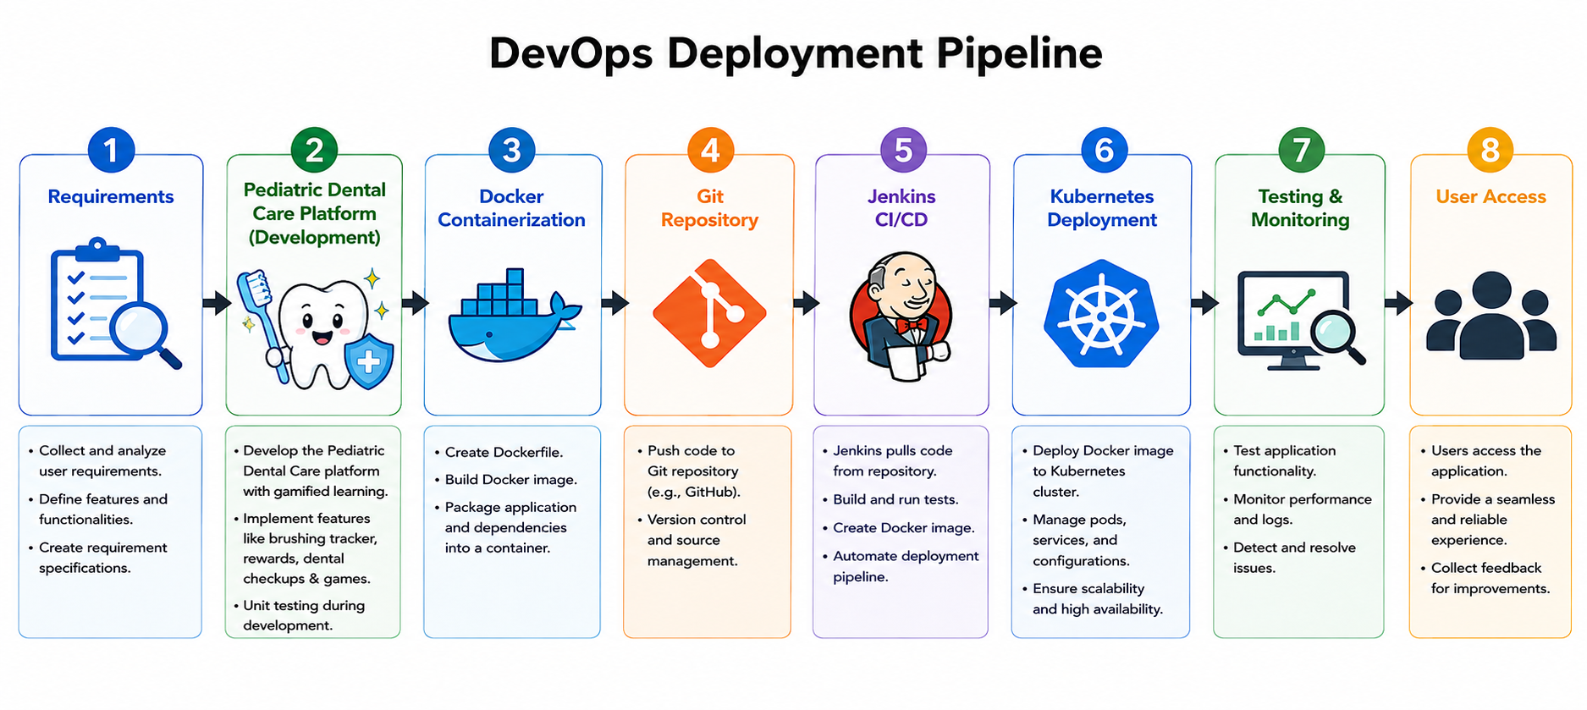
System Design / Architecture

Slide 15
Conclusion
The project demonstrates the successful DevOps-driven deployment of a gamified pediatric dental care platform using Docker, Jenkins, and Kubernetes. Docker provides consistent and portable application environments through containerization. Jenkins automates the build, testing, and deployment process using a CI/CD pipeline, reducing manual effort and deployment errors. Kubernetes ensures scalable, reliable, and highly available application deployment through orchestration, auto-scaling, and self-healing capabilities. The DevOps approach enables faster software delivery, reduced downtime, and simplified application maintenance.

Slide 16
Future Scope
Integrate Artificial Intelligence (AI) to provide personalized dental care recommendations and oral health risk prediction.
Develop Android and iOS mobile applications for improved accessibility.
Add tele-dentistry features for virtual consultations with dentists.
Implement cloud-based deployment for greater scalability and disaster recovery.
Enhance security using advanced authentication and data encryption to protect patient information.

Slide 17
References
Kumar, R., & Garg, S. (2022).Detection of Toxic and Abusive Language in Social Media using Deep Learning.International Journal of Computer Applications (IJCA).
Risch, J., Stoll, A., Wilms, L., & Krestel, R. (2022).Overview of the GermEval 2021 Shared Task on the Identification of Toxic, Engaging, and Fact-Claiming Comments.
Mozafari, M., Farahbakhsh, R., & Crespi, N. (2022).
Hate Speech Detection: A Solved Problem? The Challenging Case of Long Tail on Twitter.
Information Processing & Management, Elsevier.
Pavlopoulos, J., Sorensen, J., Laugier, L., & Androutsopoulos, I. (2022).

Slide 18
THANK YOU

